Slide 1

SAP Build Training for Corporate Professionals
DAY-10
www.anubhavtrainings.com

Slide 2


DISCLAIMER
The training content and delivery of this presentation is confidential, and cannot be recorded, or copied and distributed to any third party, without the written consent of Anubhav Trainings

Slide 3
Agenda
iRPA
Introduction to iRPA
Agent
Installing agent
Scenario
Mass order approval
Parallel branch
Working with parallel branch

Slide 4

Scenario – Mass order management
We are working in a warehouse, where we receive bulk orders for multiple customer. Till now our company was dispatching orders to each customer one by one, how there is a need to process all the customer orders in bulk (mass order management).
We already have a business process to manage single order of a customer and trigger the email to respective customer, our goal is to design a new process where the current process be added inside a loop as a sub process and call it multiple time for each order of same customer.

Slide 5

























Slide 6
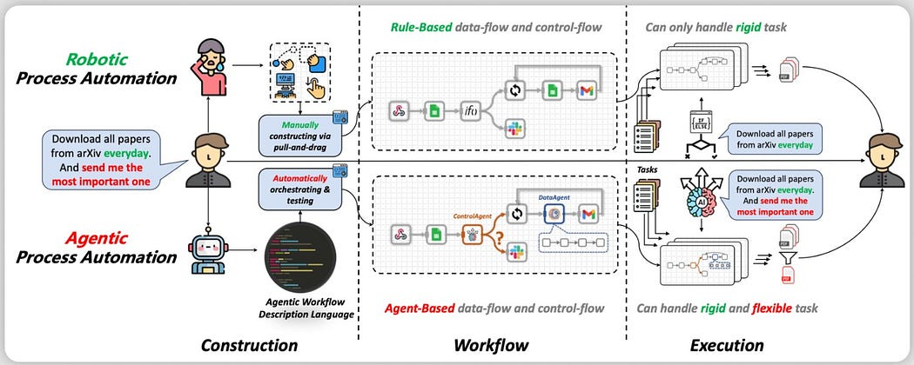
iRPA
Robotic Process Automation (RPA) has been used to automate mundane and complicated business processes. RPA uses software robots to automate the boring stuff done by humans such as data entry, transaction processing, web scrapping and so forth.

Slide 7
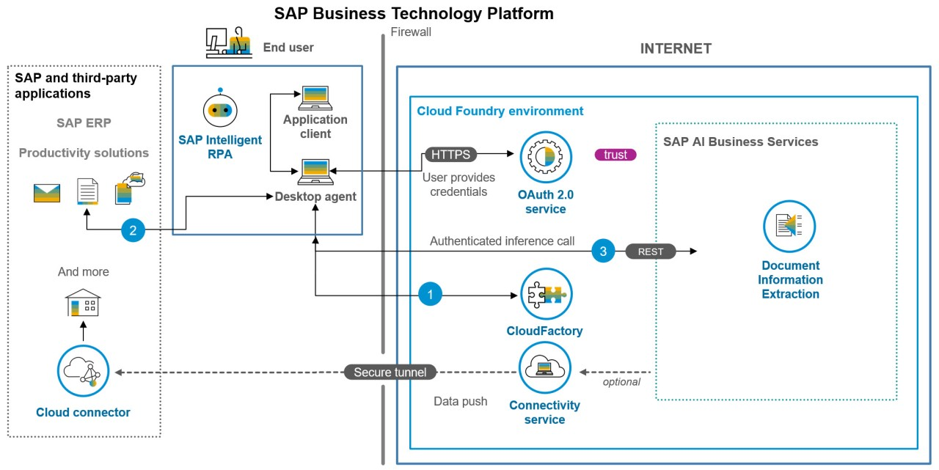
The Design

Slide 8
What is iRPA Desktop agent?
The Desktop Agent is a component of SAP Build Process Automation that is installed locally on user desktops. It executes automation projects that launch and run applications of various kinds, reads information from screens, enters data, clicks options, and processes data.
Projects are assigned to tenants running on a Desktop Agent. You can see what your Desktop Agent is doing at all times thanks to the convenient system tray, or Systray, that is always accessible while your Desktop Agent is ready or active.
When it is installed, the Desktop Agent is configured to start at Windows logon automatically. You should not change this setting because your Agent might be assigned background (unattended) jobs at any time.
The very first time you launch the Desktop Agent on your workstation, you will be prompted to log in. If you are unsure of your login details, please ask an administrator.

Slide 9
Steps to configure Desktop agent
Download the Desktop agent (RPA agent) 3.0 – https://tools.hana.ondemand.com/#cloud
Added the agent to control tower settings
Register the agent in the environment
Set the mode as unattended mode
Enable the browser plugin with allowed settings in chrome
Guide for desktop agent 3
https://help.sap.com/doc/dd104fba73bd4ac19abf88080ff88512/Cloud/en-US/1d297d6d159346dcb94928b90c019b9e.pdf
If you plan to use productive Desktop agent, follow the guide below (permission for SAP software downloads)
https://developers.sap.com/tutorials/spa-setup-desktop-3-0-agent..html

Slide 10

The Scenario – Invoice Approval
Sonia is working at Anubhav Trainings finance department; every we create and send invoices to the customer. Her job is to check the invoices, especially the amount and module name for each invoice and validate if the payment has been received in the bank account.
Currently she has to open every invoice manually and read the invoice amount, date and course name and validate the date & amount submitted by internal sales team.
She want us to automate this process where the sales team share the invoice details along with date and we need to send approval form only when date match with pdf invoice to Sonia. She reviews the details and provide invoice approval.
On approved an email will trigger to student that their payment has been received for the course.

Slide 11
Flow

Slide 12
Document template
The template will define the skeleton of the pdf document which helps RPA component (bot) to understand where which field of data is present. So, at runtime the bot can extract the exact data for us from pixel position of the pdf document.

Slide 13

What We Did
Let’s Summarize
www.anubhavtrainings.com

Slide 14
www.anubhavtrainings.com
Thank You
End of Day 10
www.anubhavtrainings.com

Slide 15



We’re committed to empower you to be
#FutureReady
through powerful training solutions.
We build the workforce of the future.
250+
Corporate Clients
30,000+
Learners Trained
25000+
Learners Placed
FREE WEBINARS
Sign up for free webinars with industry experts every fortnight!
Enroll Now!
Contact us today!
https://anubhavtrainings.com

